Slide 1
Concepts of Boolean Algebra

Slide 2
Lecture 12 Introduction to Boolean algebra
Lecture delivered by:
Deepak V.

Slide 3
Topics
Introduction to Boolean algebra
Boolean Operations & Expressions
Basic Boolean Equations
2 Level Logic
Boolean Addition
Boolean Multiplication

Slide 4
Objectives
At the end of this lecture, student will be able to:
Acquire the knowledge of Boolean Algebra
Identify basic Boolean operations & expressions
Describe of 2 Level Logic
Acquire the knowledge of Boolean Addition
Acquire the knowledge of Boolean Multiplication

Slide 5
Boolean Algebra
1854: Logical algebra was published by George Boole → known today as “Boolean Algebra”
It’s a convenient way and systematic way of expressing and analyzing the operation of logic circuits
1938: Claude Shannon was the first to apply Boole’s work to the analysis and design of logic circuits
Boolean algebra is a mathematical system for the manipulation of variables that can have one of two values

Slide 6
Boolean Operations & Expressions
Variable – a symbol used to represent a logical quantity
Complement – the inverse of a variable and is indicated by a bar over the variable
Literal – a variable or the complement of a variable

Slide 7
Basic Boolean Equations
For the basic gates/functions
AND
Z = A B
X = C D E 3 input gate
Y = F G H K 4 input gate
OR
Z = A + B
Y = F + G + H + K 4 input gate
NOT
Z = A
Y = (F G H K) actually 2 level logic

Slide 8
2 Level Logic
Consider the following logic equation
Z(A,B,C,D) = A B + C D
The Z(A,B,C,D) means that the output is a function of the four variables within the ().
The AB and CD are terms of the expression.
This form of representing the function is an algebraic expression.
For this function to be True,
Either both A AND B are True
OR both C AND D are True.

Slide 9
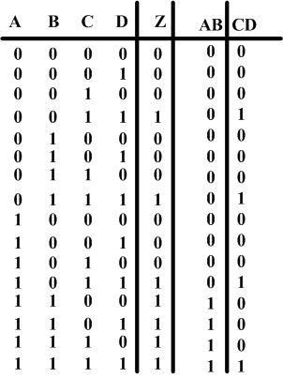
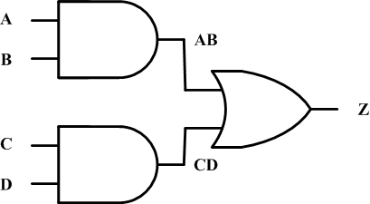
Truth table expression
Just like we had the truth tables for the basic functions, we can also construct truth tables for any function.

Slide 10
Boolean Addition and Multiplication
Boolean Addition and Multiplication
The OR operation is often called Boolean addition. Variables that are ORed together form a sum term
The AND operation is often called Boolean multiplication. Variables that are ANDed together form a product term
Example #1
The expression (A+B+C)(D+E) is the product of two sum terms.
Example #2
The expression AB + CD + AD is the sum of three product terms.

Slide 11
Boolean Addition
Boolean addition is equivalent to the OR operation
A sum term is produced by an OR operation with no AND ops involved
i.e.
A sum term is equal to 1 when one or more of the literals in the term are 1
A sum term is equal to 0 only if each of the literals is 0
0+0 = 0
0+1 = 1
1+0 = 1
1+1 = 1

Slide 12
Boolean Multiplication
Boolean multiplication is equivalent to the AND operation
A product term is produced by an AND operation with no OR ops involved
i.e.
A product term is equal to 1 only if each of the literals in the term is 1
A product term is equal to 0 when one or more of the literals are 0
0·0 = 0
0·1 = 0
1·0 = 0
1·1 = 1

Slide 13
Summary
Boolean algebra is a mathematical system for the manipulation of variables that can have one of two values
Variable is a symbol used to represent a logical quantity
Complement is the inverse of a variable and is indicated by a bar over the variable
Literal is a variable or the complement of a variable
A sum term is produced by an OR operation, AND operation not involved
A product term is produced by an AND operation, OR operation not involved

